Slide 1
Introduction to Azure Event Grid
Creating event driven architecture in the cloud
Callon Campbell - @flying_maverick
Systems Architect

Slide 2
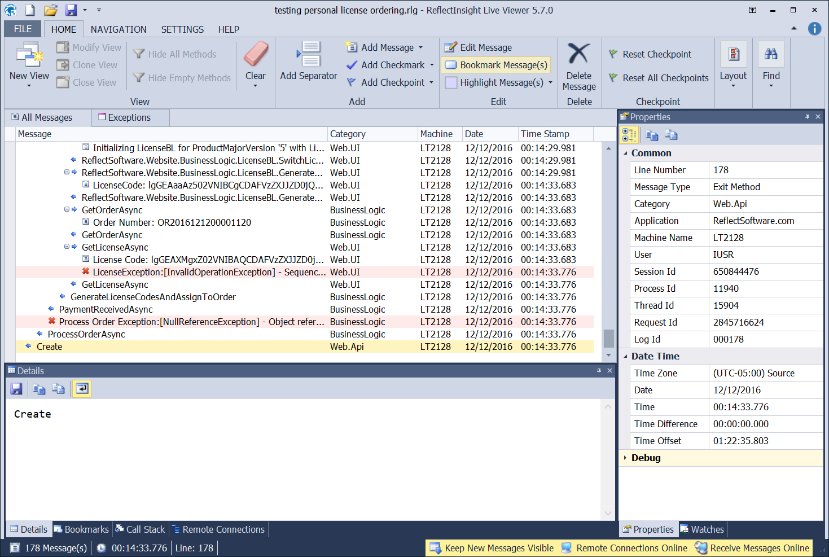
About me
Callon Campbell
Systems Architect / Developer with 20 years of experience developing desktop, mobile and web enterprise applications using .NET, SQL Server, Mobile and Azure technologies.
Co-creator of ReflectInsight, a .NET logging framework and a real-time Live Log Viewer.
Email: | CallonCampbell@Outlook.com | Twitter: | @Flying_Maverick
Blog: | http://TheFlyingMaverick.com | LinkedIn: | LinkedIn.com/in/calloncampbell
Website: | http://ReflectInsight.com | Slideshare: | https://www.slideshare.net/calloncampbell

Slide 3
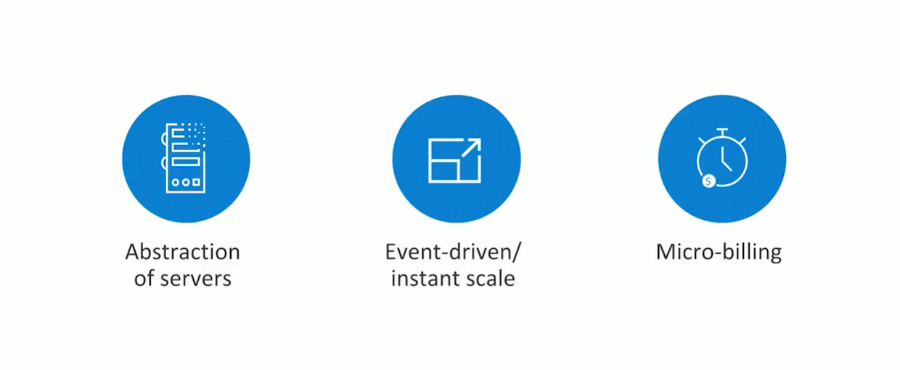
What is serverless?
Notes:
The essence of serverless is less server. The details of the server are abstracted away from you.
You don’t need to worry about optimizing which operating system to run on, patching, etc
Don’t need to worry about optimizing utilization and scaling up and down for demand
Event driven process
Tell Azure how or when to run your code (is it based on a schedule, or when a new customer is added to salesforce, or when items are added to a queue, a table or storage, etc)
Micro build
You’re only charged for the usage.

Slide 4
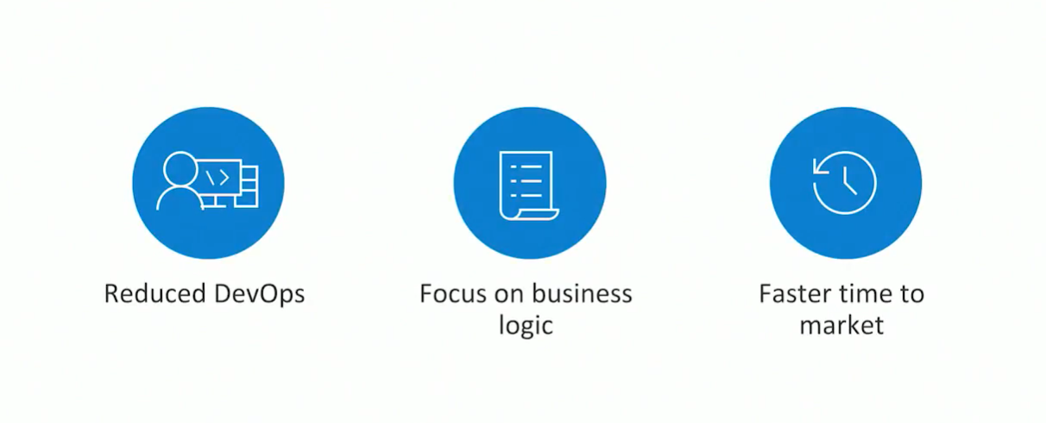
Benefits of serverless
Notes:
Dynamically and elastically scale to meet demand.
Allows you as the developer to focus on your business logic. Everything else is taken cared for you.
This drastically increases time to market.

Slide 5
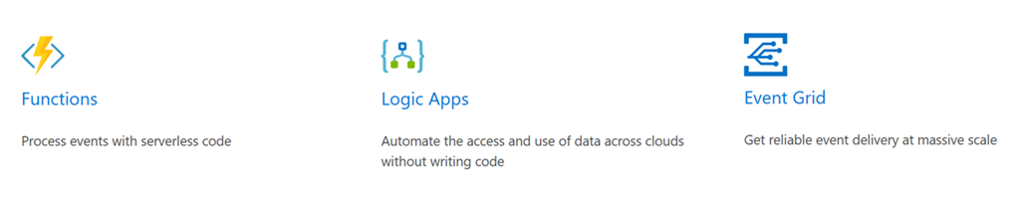
Azure serverless offerings
There are three components to Azure serverless:
Notes:
It’s now becoming easier than ever to create small, targeted microservice architecture using a variety of services.
Azure provides services like Azure Functions, Logic Apps, and Event Grid that can help you achieve a low-friction, high-throughput and low-cost solution.

Slide 6

What is Event Grid?
New messaging service for event-based architectures
Fully-managed event routing service utilizing a publisher-subscriber model
Built-in support for events coming from other Azure services
Handles routing and delivery of events from a number of sources and subscribers
Is agnostic to any language or platform
Notes:
3. Simply select the Azure resource you would like to subscribe to, and give the event handler or webhook endpoint to send the event to.
5. While Event Grid integrates natively with Azure Services, it can just as easily be leveraged by anything that supports the HTTP protocol.

Slide 7
Why use Event Grid?
Designed for reactive, event-driven apps
perfect for your serverless and microservice apps
Reliable event delivery at massive scale
High availability, consistent performance, and dynamic scale
Notes:
Event Grid plugs the gap existing in Microsoft’s Serverless platform and brings together event publishers and event consumers in a loosely coupled form.

Slide 8
Why use Event Grid (cont)
Lightweight serverless messaging infrastructure that enables you to publish and consume events from any application
Provides support for virtually any existing Azure service
Provides support for custom end points

Slide 9
Anatomy of Event Grid
Events - What happened
Event sources/publishers - Where the event took place
Topics - The endpoint where publishers send events
Event subscriptions - The endpoint or built-in mechanism to route events, sometimes to multiple handlers
Event handlers - The app or service reacting to the event
Filters – Can be applied to event types or event subject
Notes:
Subscriptions are also used by handlers to intelligently filter incoming events.

Slide 10
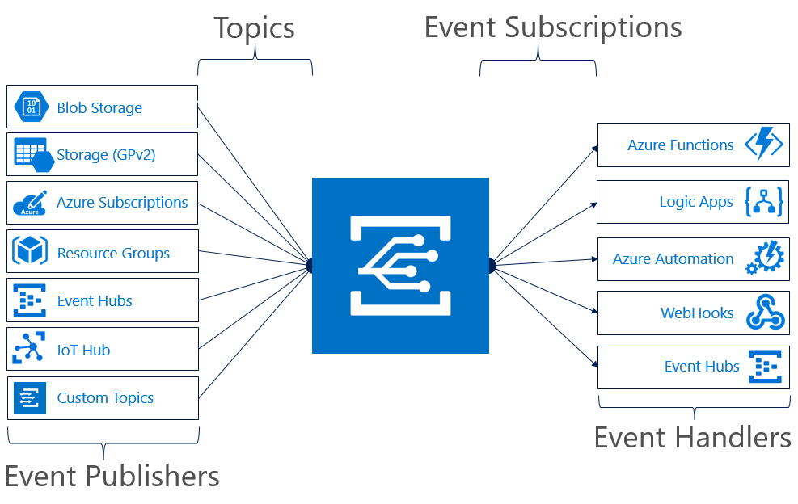
Topics and Subscriptions
Notes:
Event Grid is similar to Azure Service Bus in that a Topic is an endpoint that receives messages, and a Subscription is used to receive messages through the Topic that will be handled by a message listener. These concepts are basically the same, but there are some differences in how they work.
Event Grid uses a concept of events instead of messages since it’s an event-based messaging system. Because its based on events, it lends itself nicely to microservice architectures using serverless compute options like Azure Functions and Logic Apps.
NOTE: If using Azure Functions as your handler, use the Event Grid trigger over the generic HTTP trigger as it automatically validates Event Grid Function triggers.

Slide 11
Value added of Event Grid
Eliminates long polling and hammer polling
Native integrations
React to events with serverless code
Enables Fan out
Reliable delivery (24hr retry policy)
Event filtering
Makes your event part of a larger ecosystem
Notes:
Azure Event Grid completes the missing half of serverless applications, and simplifies event routing and event handling with unparalleled flexibility.

Slide 12
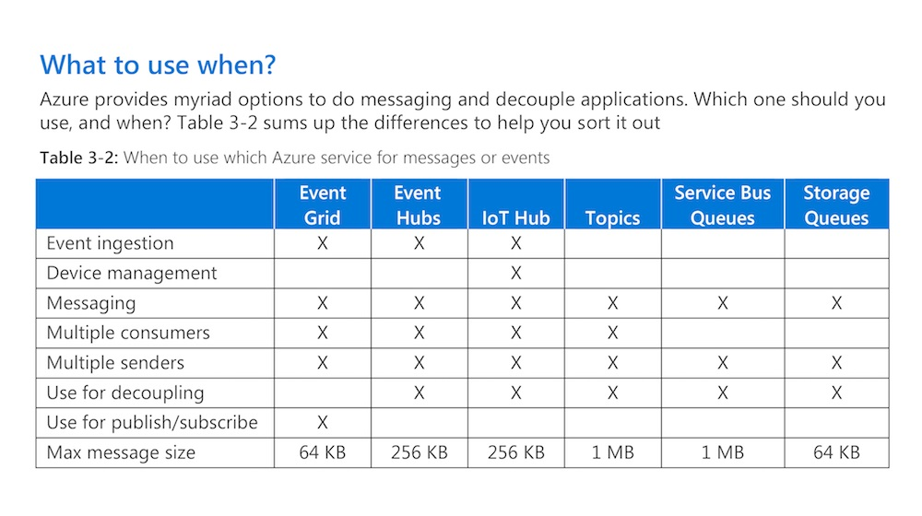
Another messaging solution
Notes:
How does it compare to other Azure messaging solutions?

Slide 13
Differences from other message queue services
Event Hub – used for ingesting high velocity telemetry data from sensors and other streaming sources
Service Bus – Created to enable hybrid connectivity between on-premises enterprise applications behind the firewall to securely connect with cloud services
Notes:
For existing users of Azure, Event Grid might remind you of Event Hubs or Service Bus but Event Grid is very different from these two services.

Slide 14
With Azure Event Grid
Its centered around speed, scale, breadth, and low cost
Its a lightweight notification of a condition or state change
Rather than being a general/generic messaging service, Event Grid is built specifically for serverless architectures

Slide 15
Types of Event Requests
Event Grid will send to it’s subscribers two types of requests:
Subscription Validation
Notification

Slide 16
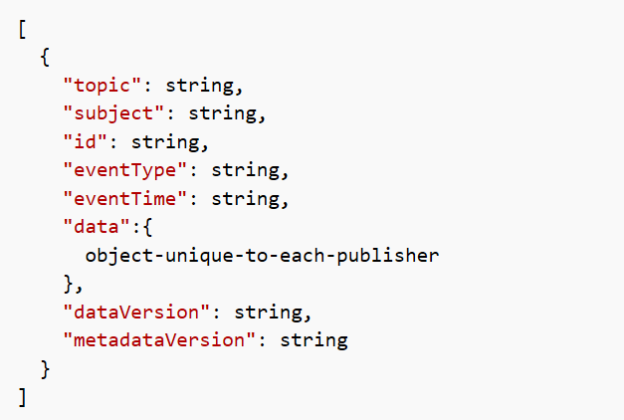
Message Schema
Events are sent to Azure Event Grid in an array, which can contain multiple event objects
The array can have a total size of up to 1 MB. Each event in the array is limited to 64 KB
Notes:
1b. If there is only a single event, the array has a length of 1

Slide 17
Reliable Delivery
Event Grid uses HTTP response codes to acknowledge receipt of events. In the event of failure Event Grid retries delivery
Uses an exponential back off retry policy for event deliver (10s, 30s, 1m, 5m, 10m, 30m, 1 hr)
Retry duration expires after 24 hr

Slide 18
Security and Authentication
Azure Event Grid has three types of authentication:
Event subscriptions
Event publishing
WebHook event delivery

Slide 19
Webhook Endpoints
When registering your own WebHook endpoint, Event Grid will send a POST request with a simple validation code to prove endpoint ownership.
Your app needs to respond by echoing back the validation code.
Notes:
Event Grid won’t deliver events to WebHook endpoints that haven't passed validation

Slide 20
Demo
Notes:
https://portal.azure.com/
I’ll now show you how to get started creating and running a simple HttpTrigger function from the Azure Portal.

Slide 21
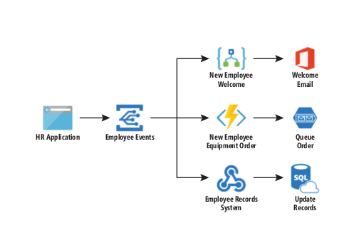
A serverless sample
Notes:
This example is curtesy of MSDN Magazine and illustrates how you can use Event Grid to pass events or commands to Azure Functions and Logic Apps.
https://msdn.microsoft.com/en-ca/magazine/mt829271/
I’ll simulate an HR application from PostMan and send an event to a specific topic in Event Grid

Slide 22
Common scenarios for Event Grid

Slide 23
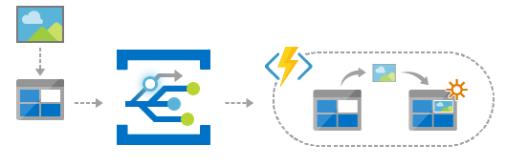
Serverless application architectures
Azure Event Grid is designed to be used in microservices and event based architectures
Notes:
It can be used in a serverless application to connect data sources and event handlers.
In this example, use Event Grid to trigger a serverless function to run image analysis each time an image is added to blob storage

Slide 24
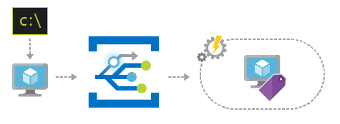
Ops Automation
Event Grid allows you to speed automation and simplify policy enforcement
Notes:
2. In an ops automation scenario you can notify Azure Automation when virtual machines are created, or when a SQL database is spun up.

Slide 25
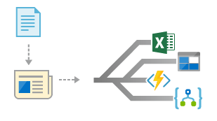
Application integration
Event Grid is used to connect your app to other services
Notes:
3. Finally you can use Event grid to connect your application with other services. The possibilities are really limited by your imagination.

Slide 26
Pricing

Slide 27
Pricing
Azure Event Grid uses a pay-per-event pricing model, so you only pay for what you use
The first 100,000 operations per month are free
Price per million operations are $0.73
Operations are defined as
event ingress
advanced match
delivery attempt
management calls
Notes:
Click to show more pricing scenarios https://azure.microsoft.com/en-ca/pricing/details/event-grid/

Slide 28
Scenario 1
You publish 5 million events to Event Grid in a month
All events are published to 1 https endpoint
Total monthly cost is $7.223

Slide 29
Scenario 2
You publish 5 million events to Event Grid in a month.
All events are published to 2 https endpoints
1 million of the events require advanced matching
Total monthly cost is $11.60

Slide 30
Scenario 3
You publish 5 million events to Event Grid in a month
All events are published to 2 https endpoints
1 million of the events require advanced matching
1 million of the events required 2 delivery attempts
Total monthly cost is $12.33

Slide 31
Summary

Slide 32
Summary
Event Grid is much lighter than the other messaging services available in Azure
Event Grid can be used as intra-service communication for microservice and serverless applications
Azure Event Grid manages all routing of events from any source, to any destination, for any application
Notes:
As Microsoft keeps adding additional event sources, Event Grid becomes more useful and powerful. It will evolve as an ultimate messaging channel to receive every notification related to the current state of a workload deployed in Azure.

Slide 33
Summary (cont.)
Azure Event Grid is truly a game-changing service and is a key component to Microsoft’s serverless strategy
Notes:
Microsoft is making inroads with its serverless strategy and Event Grid has the potential to become one of the key pillars in their Azure Serverless platform

Slide 34

Thank you!
CallonCampbell@Outlook.com
TheFlyingMaverick.com
@Flying_Maverick

Slide 35
References
https://azure.com/eventgrid
Azure Event Grid Documentation
Azure Event Grid event schema
Choose between Azure services that deliver messages
Pricing

